Slide 1
DIGITAL VISION AND ROADMAP: Sample Deliverables

Slide 2

Consumer Goods Industry- Business reference architecture
Customer, Consumer & Employee Engagement
Web/Portal
App
Social
Email
Partner Site
Smart Contracts
Chat bots
Events
Live Chat
Kiosk
Mobile App
IVR
Fax
Call Center
Idea to Market
Market to Order
Product Development
Sales & Marketing
Retail Execution
Service Management
Consumer Engagement
Ideation & Concept
Category Management
Customer Segment
/Development
Scheduling
Customer Call Handling
Content Management
R&D
Marketing Insights
Sales Planning &
Forecasting
Route Execution
Warranty & Repair
Partner Collaboration
Product Design
Trade Promotions
Assortment &
Space Planning
In Store Execution
Field Service
Complaints
Commerce
Product Development
Pricing Optimization
Portfolio Management
Campaign Management
Customer Agreements
Order Management
Product Service
Social
Procure to Pay & Order to Cash
Supply Chain
Demand & Supply Planning
Plant Planning & Operations
Partner Collaboration
Order Mgmt. & Fulfillment
Warehouse Operations
Transportation Management
Smart Packaging
Support Functions
Corporate
Financial Accounting
Human Resources
Legal & Corp Affairs
Tax & Treasuries
Misc.

Slide 3
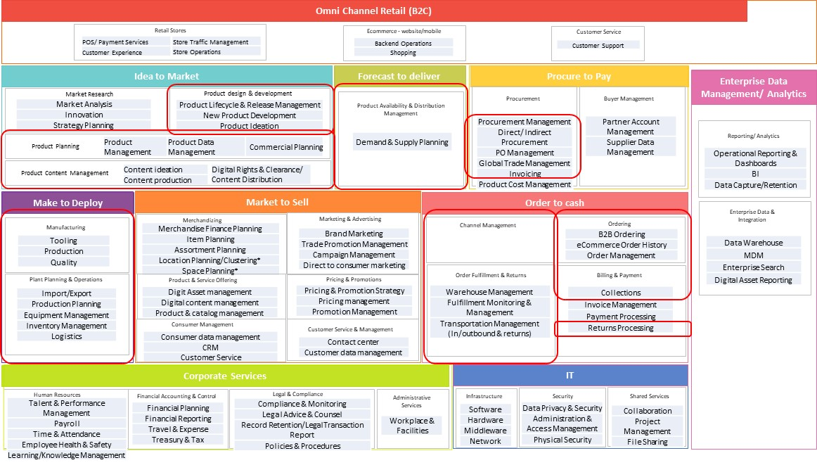
Consumer Goods Industry- Business reference architecture / Alternate View

Slide 4
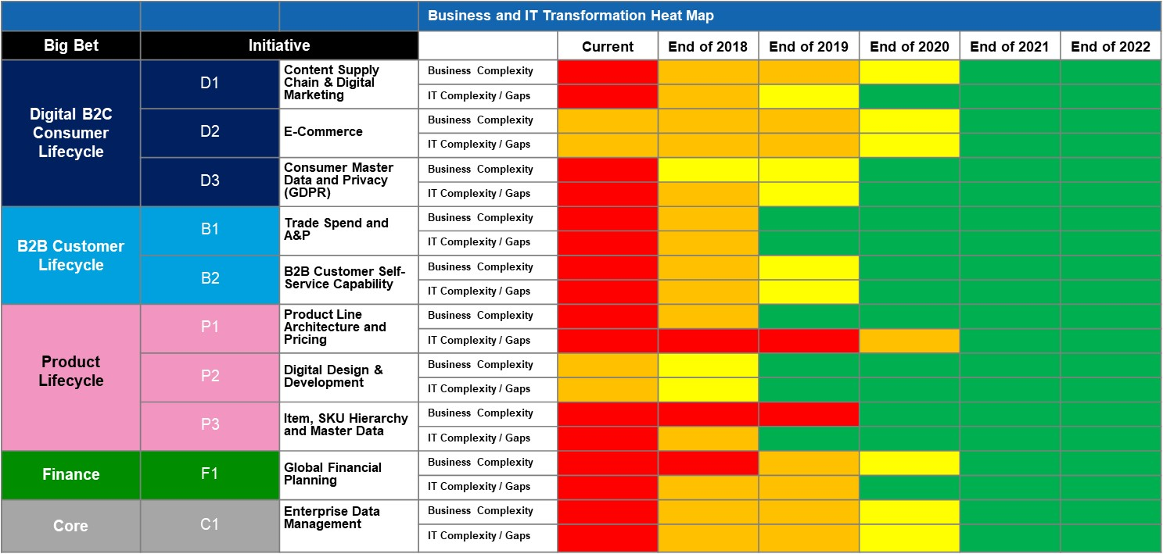
Technology Roadmap

Slide 5
Conceptual Technical Future State
Legend
eCommerce System - Magento
Web page
redirection
Salesforce
Cart
Adobe Experience Manager
Magento Cloud Features
Product Catalogue
Order creation/ cancellation & History
Subscriptions & Recurring Billing
User Profile & Auth (IDP)
Customer Support
Product Pricing
Promos, & Bundles
3rd Party Integrations
Order Processing
MMA
Marketing Cloud
Service Cloud
Changed/Modified App
Check-out & Recurring Billing
Inventory Management
(PO, Stock count update)
Agent Store
SSO integration(SAML)
Credit Card Tokenization
Data Owners
iFrame integration
Data SoT – Customer Auth profile & Emails
ERP Features
Return Processing
Integration Plugins
Data Sync
Agent Store
Integration Tool
3PL & Order Fulfillments
NSO/NON-EDI/EDI Orders
CRM ecommerce Transactions
Data SoT – Customer, Order, Billing, Contracts
Optimized Solution:
eCommerce Features transitioned from SAP to Magento
Manage My Account – transitioned to Magento
Integration: consolidation to Workato – new integration tool; standardized data transfer / sync across applications
Intuitive site design and advanced experience-building tools
c
3rd Party Solutions
Shipment
FedEx
Integration Tool
User policies
PactSafe
Products,
Pricing
Promotions
Orders
Subscriptions
Return
orders
Warranty details
Contec –Warranty
NetSuite - ERP
Tokens
CyberSource
Accounting
Invoicing
Revenue Recognition
Fulfillment completion
Settlements
Delego
Taxes
Onesource – Tax calculation
Inventory Management
(COGS,/Replenishment)
Data SoT – Revenue, Accounting
Address
Experian - Address
Inventory
updates
Order & RMA
Fulfillment
Genco
Current State

Slide 6
CAPABILITY ROADMAP: MOBILE

Slide 7
BUSINESS CASE – SCREEN SHOTS
BENEFITS
R O I
COSTS
ASSUMBTIONS

